Slide 1

Online Encounter 21
Notes:
ENCOUNTER 21
REVIEW STUDENT PROGRESS
Check if this is a Student’s first Encounter. If it is, plan time to welcome the Student.
For other Students, check for last Encounter attendance.
Check for last Speaking Center attendance and time spent.
Check that Lesson 3 has been completed.
Prepare general comments on Student attendance, study habits, and overall progress.
VIDEO SUMMARY
Sofi arrives at the restaurant and finds out from Diego that Danielle won’t be at work, so Sofi and Diego plan to take care of the cooking. When Danielle does come in—very late—Nadi fires her, but Danielle quits instead.
At the apartment, Shen gets an email from his parents saying they would like to come from China to visit him in New York. Then he gets an email from his agent, Marti, telling him about a new gig teaching acting. When he goes to tell Benny the news, he finds his roommate playing video games with Li Li.
At The Company Company, Khae and Marco discuss the business, including the number of employees and products the company makes, as well as salaries, while they wait in line for new IDs. Aanya soon joins them.
READING SUMMARY
Common kitchen rules, including safety instructions and sanitary practices, are explained in a message to employees of a restaurant.
In a text message exchange, a woman, Sanam, informs her friend Jan that she will be visiting San Francisco with her husband, who is going there on a business trip. Jan invites Sanam to stay with her, but Sanam tells her that her husband’s company is paying for in a hotel. Both women are looking forward to the visit.
AUDIO SUMMARY
Two friends, Mark and Anna, trade voicemails back and forth as they are having trouble getting in touch with each other. Through the voicemails, they arrange to meet for dinner. Finally, they get each other on the line. Mark tells Anna where his hotel is located so that she can pick him up there.
VOCABULARY OBJECTIVES
Can name very common types of containers (can; jar; pack; packet; pot; tin)
GRAMMAR OBJECTIVES
Can use very basic connectors (e.g., and, but, or, then) (I have to take off my jacket and then put on my hat.)
Can use a range of possessive adjectives (e.g., its, our, their) (It’s my food.)
Can show possession using ’s with some control (Marco’s ID is funny.)
SPEAKING OBJECTIVES
Can use simple phrases to ask for and provide things, and to discuss what to do next (Can you give me your ID?)
Can demonstrate a basic understanding of verb–noun agreement, but with limited control (There is one box of candles.)

Slide 2

Encounter 21
Introductions
Your teacher
My name is .
Now please introduce yourself.
Notes:
INSTRUCTIONS
This is a warm-up activity and should not be assessed.
Introduce yourself to the Students. Then ask each individual Student what his/her name is. Tell the Students:
Hello. My name’s _______. What’s your name?
Sample Responses: My name’s _______./My name is _______.
TEACHING TIPS
Ask the Students about their study habits. (e.g., Have you finished your Speaking Center Lessons? How about your Student Manual or Digital Book?)
Check for IT issues.

Slide 3
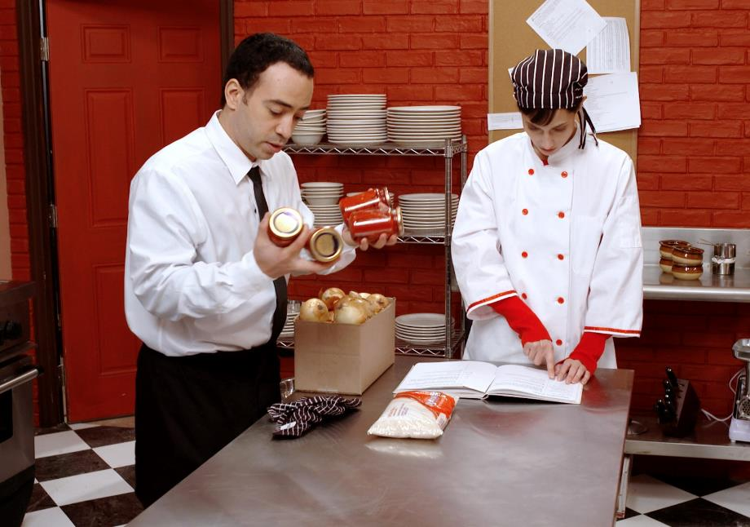
Part 1.0: Warm-Up
Notes:
At Nadi’s Restaurant (5 min)
Allow five minutes for this slide.
OBJECTIVE
To help the Students relax and start thinking in English
INSTRUCTIONS
Draw the Students’ attention to the image. Instruct the Students to first recall the names of the two people in the video. Then elicit the plot/character development from this part of the storyline. Begin with: “Tell me about the story for this unit. What are Sofi and Diego doing?”
Proceed to elicit more details about the story. Say, “Tell me about Danielle and Nadi.” (Danielle was late to work, so Nadi fires her.)
After eliciting details of the storyline, direct the Students’ attention to the characters’ emotions and feelings. Elicit the Students’ perception by asking, “Do you like the people in the story? How do you think Danielle/Sofi/Diego feel about working at the restaurant? About Nadi?”

Slide 4
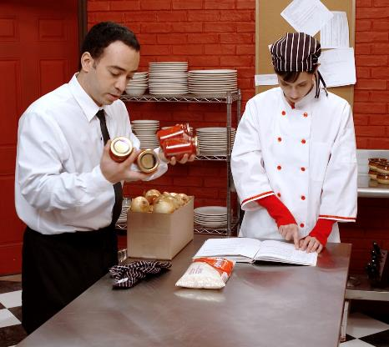
Part 2.0: Target Language
Activity 2.1: Context Creation
What does Diego get for Sofi?
ingredients
What is the rice in?
a bag
What are the tomatoes in?
rice and tomatoes
a can
Notes:
2.1 Containers (5 min)
Allow one minute for this slide.
OBJECTIVE
Can name very common types of containers (can; jar; pack; packet; pot; tin)
INSTRUCTIONS
#1. Have a Student read the question. [What does Diego get for Sofi?]
#2. Encourage the Students to answer.
#3. Reveal the sample answers. [ingredients/rice and tomatoes]
#4. Have a Student read the question. [What is the rice in?]
#5. Encourage the Students to answer.
#6. Reveal the answer. [a bag]
#7. Have a Student read the question. [What are the tomatoes in?]
#8. Encourage the Students to answer.
#9. Reveal the answer. [a can]
Then ask, “What is another name for a can?” (a tin)
TEACHING TIPS
Elicit a variety of the target vocabulary.
Elicit from each Student.
It helps to board elicited language.

Slide 5
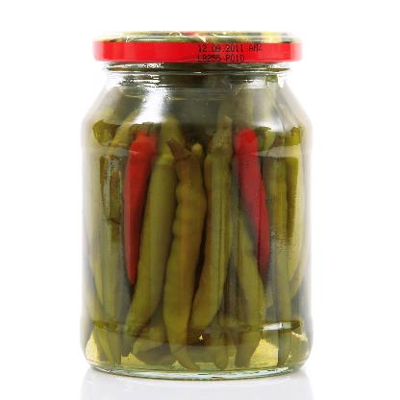
Part 2.0: Target Language
Activity 2.1: Concept Check
What’s this?
a jar of peppers
Notes:
2.1 Containers
Allow one minute for this slide.
INSTRUCTIONS
#1. Have a Student read the question. [What’s this?]
#2. Encourage the Students to answer.
#3. Reveal the answer. [a jar of peppers]
TEACHING TIP
Elicit target language from each Student.

Slide 6
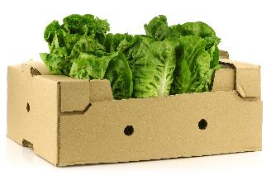
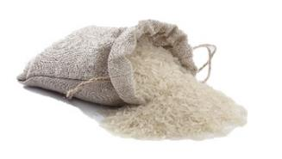
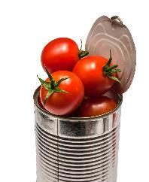

Part 2.0: Target Language
Activity 2.1: Practice
A
B
C
D
Notes:
2.1 Containers
Allow two minutes for this slide.
INSTRUCTIONS
Say to the Students, “Look at the pictures. Ask your classmates what the things are. Then answer when your classmates ask you what something is.” For example,
Student A: What’s this?
Student B: It’s a box of lettuce.
Make sure the Students ask full questions and respond in full sentences for each picture.
TEACHING TIP
Note any images from the activity that cause problems, and review them at the end of the activity.
ANSWER KEY
A. box of lettuce
B. bag of rice
C. can of tomatoes
D. jar of peppers

Slide 7
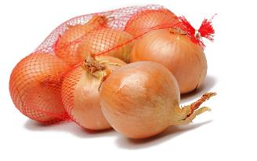
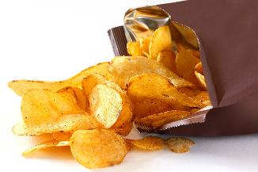
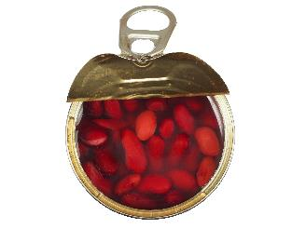

Part 2.0: Target Language
Activity 2.1: Practice
A
B
C
D
Notes:
2.1 Containers
Allow one minute for this slide.
INSTRUCTIONS
The Students have to go through all of the images taking turns asking and answering questions.
Make sure the Students ask full questions and respond in full sentences for each picture.
ANSWER KEY
A. bag of onions
B. bag of chips
C. can of beans
D. packet of sugar

Slide 8
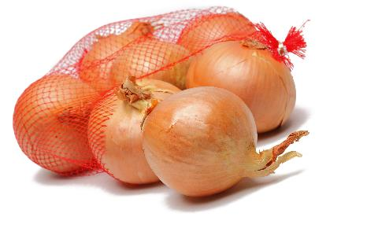
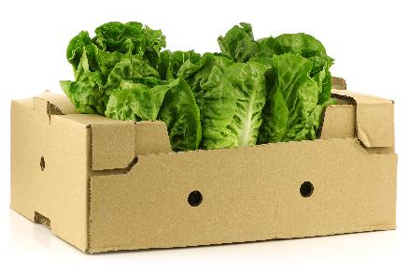
Part 2.0: Target Language
Activity 2.1: Extension
Would you like to buy a bag of onions or a box of lettuce?
I’d like onions.
to buy a bag of
buy?
or
Notes:
2.1 Containers
Optional Extension
INSTRUCTIONS
#1. Have a Student read the question. [Would you like to buy a bag of onions or a box of lettuce?]
#2. Encourage the Students to answer.
#3. Reveal the example answer. [I’d like to buy a bag of onions.]

Slide 9


Part 2.0: Target Language
Activity 2.1: Extension
buy?
or
Notes:
2.1 Containers
Optional Extension
INSTRUCTIONS
Draw the Students’ attention to the text at the top of the screen and the two images. Encourage the Students to use these cues to ask and answer “Would you like to buy a bag of chips or a can of beans?”
ANSWER KEY
Student A: Would you like to buy a bag of chips or a can of beans?
Student B: I'd like to buy...

Slide 10

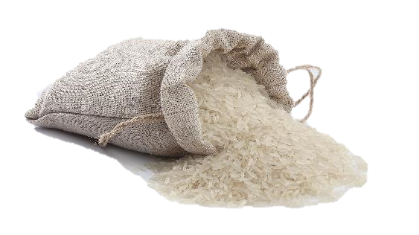
Part 2.0: Target Language
Activity 2.1: Extension
buy?
or
Notes:
2.1 Containers
Optional Extension
INSTRUCTIONS
Draw the Students’ attention to the text at the top of the screen and the two images. Encourage them to use these cues to ask and answer “Would you like to buy a packet of sugar or a bag of rice?”
ANSWER KEY
Student A: Would you like to buy a packet of sugar or a bag of rice?
Student B: I'd like to buy...

Slide 11
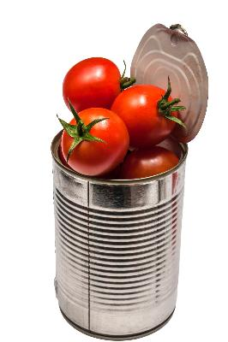
Part 2.0: Target Language
Activity 2.1: Extension
buy?
or
Notes:
2.1 Containers
Optional Extension
INSTRUCTIONS
Draw the Students’ attention to the text at the top of the screen and the two images. Encourage them to use these cues to ask and answer “Would you like to buy a jar of peppers of a can of tomatoes?”
ANSWER KEY
Student A: Would you like to buy a jar of peppers of a can of tomatoes?
Student B: I'd like to buy...

Slide 12


Part 2.0: Target Language
Activity 2.1: Extension
buy?
or
Notes:
2.1 Containers
Optional Extension
INSTRUCTIONS
Draw the Students’ attention to the text at the top of the screen and the two images. Encourage them to use these cues to ask and answer “Would you like to buy a box of lettuce or a can of beans?”
ANSWER KEY
Student A: Would you like to buy a box of lettuce or a can of beans?
Student B: I'd like to buy...

Slide 13
Part 2.0: Target Language
Activity 2.1: Feedback
Student 1
Student 2
Student 3
Student 4
Great job!
Great job!
Great job!
Great job!
Well done
Well done
Well done
Well done
Good try
Good try
Good try
Good try
More practice
More practice
More practice
More practice
Feedback
Notes:
2.1 Containers
FEEDBACK
Quickly give the Students feedback on the target language they just practiced.
Remind them of other resources they can take advantage of to improve their English:
Go to Wall Street World to practice grammar and vocabulary.
Review the Student Manual or Digital Book to study grammar and vocabulary.
Attend Complementary Classes to practice using grammar and vocabulary.
Join Social Clubs to practice speaking skills.

Slide 14

Part 2.0: Target Language
Activity 2.2: Context Creation
.
Can I have a bag of rice?
Here you are
.
I’d like a bag of rice, please
Can you give me that bag of rice?
I want a bag of rice. What do I say?
Notes:
2.2 Can I Have a Bag of Rice? (5 min)
Allow one minute for this slide.
OBJECTIVE
Can use simple phrases to ask for and provide things, and to discuss what to do next (Can you give me your ID?)
INSTRUCTIONS
#1. Have a Student to read the statement and question. [I want a bag of rice. What do I say?]
#2. Encourage the Students to answer.
#3. Reveal the answer. [I’d like a bag of rice, please./Can I have a bag of rice?]
#4. Have a Student read the question. [Can you give me that bag of rice?]
#5. Encourage the Students to answer. If the Students do not respond with “Here you are,” ask, “What do you say when you give me the bag of rice?”
#6. Reveal the answer. [Here you are.]
TEACHING TIPS
Elicit a variety of the target vocabulary.
Elicit from each Student.
It helps to board elicited language.

Slide 15

Part 2.0: Target Language
Activity 2.2: Concept Check
Can I have a packet of sugar?
.
Here you are
What do I say if I want some sugar?
What do you say if you give me the packet of sugar?
Notes:
2.2 Can I Have a Bag of Rice?
Allow one minute for this slide.
INSTRUCTIONS
#1. Have a Student read the question. [What do I say if I want some sugar?]
#2. Encourage the Students to respond.
#3. Reveal the answer. [Can I have a packet of sugar?]
#4. Have a Student read the question. [What do you say if you give me the packet of sugar?]
#5. Encourage the Students to answer.
#6. Reveal the answer. [Here you are.]
TEACHING TIP
Elicit target language from each Student.

Slide 16

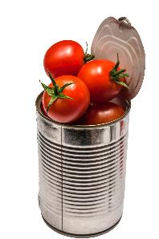

Part 2.0: Target Language
Activity 2.2: Practice
A
B
C
D
Notes:
2.2 Can I Have a Bag of Rice?
Allow two minutes for this slide.
INSTRUCTIONS
The Students have to take turns asking for and providing the objects they see on the screen. For example,
Student A: Can I have a jar of peppers?
Student B: Sure. Here you are.
Student B: Can I have a bag of rice?
Student A: Here you are.
ANSWER KEY
A. Can I have a jar of peppers?
B. Can I have a bag of rice?
C. Can I have a can of tomatoes?
D. Can I have a box of lettuce?

Slide 17

Part 2.0: Target Language
Activity 2.2: Practice
A
B
C
D
Notes:
2.2 Can I Have a Bag of Rice?
Allow one minute for this slide.
INSTRUCTIONS
The Students have to take turns asking for and providing the objects they see on the screen.
ANSWER KEY
A. Can I have a bag of onions?
B. Can I have a bag of chips?
C. Can I have a can of beans?
D. Can I have a packet of sugar?

Slide 18
Part 2.0: Target Language
Activity 2.2: Feedback
Student 1
Student 2
Student 3
Student 4
Great job!
Great job!
Great job!
Great job!
Well done
Well done
Well done
Well done
Good try
Good try
Good try
Good try
More practice
More practice
More practice
More practice
Feedback
Notes:
2.2 Can I Have a Bag of Rice?
FEEDBACK
Quickly give the Students feedback on the target language they just practiced.
Remind them of other resources they can take advantage of to improve their English:
Go to Wall Street World to practice grammar and vocabulary.
Review the Student Manual or Digital Book to study grammar and vocabulary.
Attend Complementary Classes to practice using grammar and vocabulary.
Join Social Clubs to practice speaking skills.

Slide 19


Part 3.0: Target Structures
Activity 3.1: Context Creation
I have onions. I have tomatoes. How can I say this in one sentence?
I like onions. I don’t like tomatoes. How can I put these sentences together?
Bob doesn’t like onions. Bob doesn’t like tomatoes. How can I put these sentences together?
.
I have onions and tomatoes
.
.
Bob doesn’t like onions or tomatoes
I like onions, but I don’t like tomatoes
Notes:
3.1 I Love Fruit, but I Hate Vegetables! (10 min)
Allow one minute for this slide.
OBJECTIVES
Can use very basic connectors (e.g., and, but, or, then) (I have to take off my jacket and then put on my hat.)
Can demonstrate a basic understanding of verb–noun agreement, but with limited control (There is one box of candles.)
INSTRUCTIONS
#1. Have a Student read the statements and the question. [I have onions. I have tomatoes. How can I say this as one sentence?]
#2. Encourage the Students to answer.
#3. Reveal the answer. [I have onions and tomatoes.]
#4. Have a Student read the statements and the question. [I like onions. I don’t like tomatoes. How can I put these sentences together?]
#5. Encourage the Students to answer.
#6. Reveal the answer. [I like onions, but I don’t like tomatoes.]
#7. Have a Student read the statements and the question. [Bob doesn’t like onions. Bob doesn’t like tomatoes. How can I put these sentences together?]
#8. Encourage the Students to answer.
#9. Reveal the answer. [Bob doesn’t like onions or tomatoes.]
TEACHING TIPS
Elicit examples of the target structure(s).
Elicit from each Student.
It helps to board elicited language.

Slide 20

Part 3.0: Target Structures
Activity 3.1: Concept Check
When would we use “and” to put together two sentences?
.
When the ideas are the same
When would we use “but” to put together two sentences?
.
When the ideas are not the same
Notes:
3.1 I Love Fruit, but I Hate Vegetables!
Allow one minute for this slide.
INSTRUCTIONS
#1. Have a Student read the question. [When would we use “and” to put together two sentences?]
#2. Encourage the Students to answer.
#3. Reveal the sample answer. [When the ideas are the same.]
#4. Have a Student read the question. [When would we use “but” to put together two sentences?]
#5. Encourage the Students to answer.
#6. Reveal the sample answer. [When the ideas are not the same.]
TEACHING TIP
Elicit target language from each Student.

Slide 21
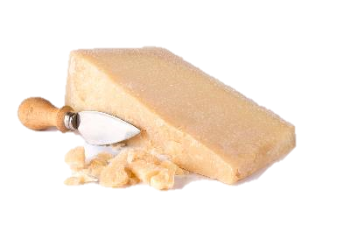


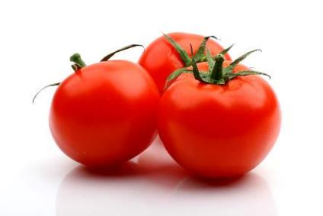
Part 3.0: Target Structures
Activity 3.1: Practice
A
like
don’t like
B
like
like
Notes:
3.1 I Love Fruit, but I Hate Vegetables!
Allow two minutes for this slide.
INSTRUCTIONS
Say, “Talk about the pictures with your classmates. Say just one sentence to describe the two things.”
Have the Students take turns talking about preferences using the images and the prompts they see on the screen.
ANSWER KEY
A. I like cheese, but I don’t like onions.
B. I like pizza and (I like) tomatoes.

Slide 22


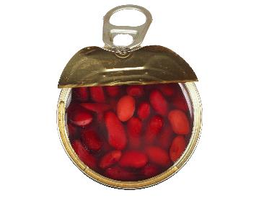
Part 3.0: Target Structures
Activity 3.1: Practice
A
don’t like
don’t like
B
don’t like
like
Notes:
3.1 I Love Fruit, but I Hate Vegetables!
Allow two minutes for this slide.
INSTRUCTIONS
Say, “Talk about the pictures with your classmates. Say just one sentence to describe the two things.”
Have the Students take turns talking about preferences using the images and the prompts they see on the screen.
ANSWER KEY
A. I don’t like coffee or tea.
B. I don’t like rice, but I like beans.

Slide 23
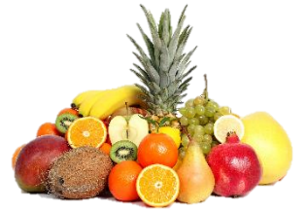


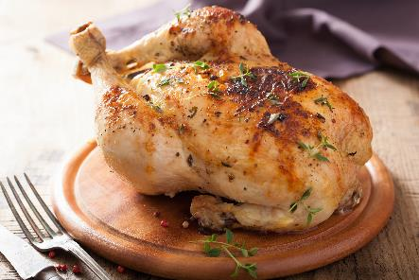
Part 3.0: Target Structures
Activity 3.1: Practice
A
don’t like
like
B
don’t like
like
Notes:
3.1 I Love Fruit, but I Hate Vegetables!
Allow two minutes for this slide.
INSTRUCTIONS
Say, “Talk about the pictures with your classmates. Say just one sentence to describe the two things.”
Have the Students take turns talking about preferences using the images and the prompts they see on the screen.
ANSWER KEY
A. I don’t like fruit, but I like bread.
B. I don’t like soup, but I like chicken

Slide 24
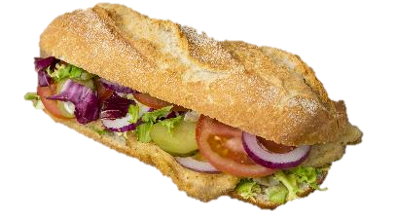

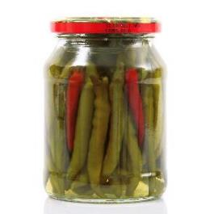

Part 3.0: Target Structures
Activity 3.1: Practice
A
like
like
B
don’t like
don’t like
Notes:
3.1 I Love Fruit, but I Hate Vegetables!
Allow two minutes for this slide.
INSTRUCTIONS
Say, “Talk about the pictures with your classmates. Say just one sentence to describe the two things.”
Have the Students take turns talking about preferences using the images and the prompts they see on the screen.
ANSWER KEY
A. I like sandwiches and (I like) chips.
B. I don’t like peppers or lettuce.

Slide 25
Part 3.0: Target Structures
Activity 3.1: Extension
.
.
Notes:
3.1 I Love Fruit, but I Hate Vegetables!
Optional Extension
INSTRUCTIONS
Ask the Students to list pairs of items. These can be anything (e.g., foods, animals, movies, celebrities, activities). Students should then discuss which they like/dislike with their classmates. For example,
I like swimming, but I don’t like running.

Slide 26
Part 3.0: Target Structures
Activity 3.1: Feedback
Student 1
Student 2
Student 3
Student 4
Great job!
Great job!
Great job!
Great job!
Well done
Well done
Well done
Well done
Good try
Good try
Good try
Good try
More practice
More practice
More practice
More practice
Feedback
Notes:
3.1 I Love Fruit, but I Hate Vegetables!
FEEDBACK
Quickly give the Students feedback on the target language they just practiced.
Remind them of other resources they can take advantage of to improve their English:
Go to Wall Street World to practice grammar and vocabulary.
Review the Student Manual or Digital Book to study grammar and vocabulary.
Attend Complementary Classes to practice using grammar and vocabulary.
Join Social Clubs to practice speaking skills.

Slide 27
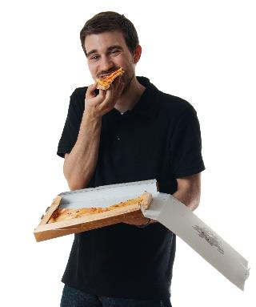
Part 3.0: Target Structures
Activity 3.2: Context Creation
Whose pizza is it?
Tim is a man. What’s another way to say “It’s Tim’s pizza”?
Yes, it’s pizza.
my
.
Whose pizza?
It’s your pizza
Tim
.
It’s pizza.
It’s his pizza
Tim’s
Notes:
3.2 Talk about Possessions (5 min)
Allow one minute for this slide.
OBJECTIVES
Can use a range of possessive adjectives (e.g., its, our, their) (It’s my food.)
Can show possession using ’s with some control (Marco’s ID is funny.)
INSTRUCTIONS
#1. Have a Student read the question. [Whose pizza?]
#2. Encourage the Students to answer.
#3. Reveal the answer. [It’s Tim’s pizza.]
#4. Have a Student read the statement and question. [Tim is a man. What’s another way to say ‘It’s Tim’s pizza’?]
#5. Encourage the Students to answer.
#6. Reveal the answer. [It’s his pizza.]
#7. Have a Student read the question. [Whose pizza is it?]
#8. Encourage the Students to answer.
#9. Reveal the answer. [It’s your pizza.]
#10. Have a Student read the text, filling in the missing word.
#11. Reveal the answer. [Yes, it’s my pizza.]
TEACHING TIPS
Elicit examples of the target structure(s).
Elicit from each Student.
It helps to board elicited language.

Slide 28



Part 3.0: Target Structures
Activity 3.2: Concept Check
It’s pizza.
It’s pizza.
It’s pizza.
his
my
her
Jack
Me
Sue
Notes:
3.2 Talk about Possessions
Allow one minute for this slide.
INSTRUCTIONS
#1. Have a Student read the text, filling in the missing possessive adjective to complete the sentence.
#2. Reveal the answer. [It’s his pizza.] (Also accept “It’s Jack’s pizza.”)
#3. Have a Student read the text, filling in the missing possessive adjective to complete the sentence.
#4. Reveal the answer. [It’s my pizza.]
#5. Have a Student read the text, filling in the missing possessive adjective to complete the sentence.
#6. Reveal the answer. [It’s her pizza.] (Also accept “It’s Sue’s pizza.”)
TEACHING TIP
Elicit target language from each Student.

Slide 29


Part 3.0: Target Structures
Activity 3.2: Practice
A
?
Michelle
B
.
you
Notes:
3.2 Talk about Possessions
Allow one minute for this slide.
INSTRUCTIONS
Call out two Students. To the first, say, “Please look at Picture A and ask, ‘Whose sandwich is this?’”. Then direct the second Student to answer.
The second Student should then ask “Whose (food item) is this?” and the first student should answer.
ANSWER KEY
A.
A: Whose sandwich is this?
B: It’s Michelle’s sandwich./It’s her sandwich.
B.
A: Whose fruit is this?
B. It’s your fruit.

Slide 30

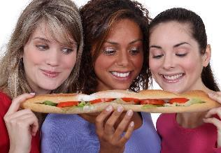
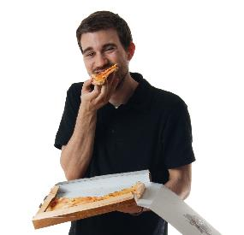
Part 3.0: Target Structures
Activity 3.2: Practice
?
A
B
.
C
Notes:
3.2 Talk about Possessions
Allow one minute for this slide.
INSTRUCTIONS
The Students take turns asking “Whose (food item) is this?” and answering based on the image.
ANSWER KEY
A.
A: Whose water is this?
B: It’s his water.
B.
A: Whose sandwich is this?
B: It’s their sandwich.
C.
A: Whose pizza is this?
B: It’s his/Tim’s pizza.

Slide 31
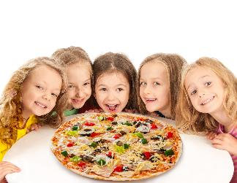


Part 3.0: Target Structures
Activity 3.2: Practice
?
A
B
.
C
Notes:
3.2 Talk about Possessions
Allow one minute for this slide.
INSTRUCTIONS
The Students take turns asking “Whose (food item) is this?” and answering based on the image.
ANSWER KEY
A.
A: Whose pizza is this?
B: It’s their pizza.
B.
A: Whose milk is this?
B: It’s his milk.
C.
Whose sandwich is this?
It’s her sandwich.

Slide 32
Part 3.0: Target Language
Activity 3.2: Feedback
Student 1
Student 2
Student 3
Student 4
Great job!
Great job!
Great job!
Great job!
Well done
Well done
Well done
Well done
Good try
Good try
Good try
Good try
More practice
More practice
More practice
More practice
Feedback
Notes:
3.2 Talk about Possessions
FEEDBACK
Quickly give the Students feedback on the target language they just practiced.
Remind them of other resources they can take advantage of to improve their English:
Go to Wall Street World to practice grammar and vocabulary.
Review the Student Manual or Digital Book to study grammar and vocabulary.
Attend Complementary Classes to practice using grammar and vocabulary.
Join Social Clubs to practice speaking skills.

Slide 33

Part 4.0: Communication
Activity 4.1: Context Creation
Do you cook at home?
.
Do you sometimes eat in restaurants?
.
What kind of restaurants do you like?
.
Notes:
4.1 Salad and a Sandwich (10 min)
Allow one minute for this slide.
OBJECTIVES
Can use very basic connectors (e.g., and, but, or, then) (I have to take off my jacket and then put on my hat.)
Can use a range of possessive adjectives (e.g., its, our, their) (It’s my food.)
Can show possession using ’s with some control (Marco’s ID is funny.)
Can demonstrate a basic understanding of verb–noun agreement, but with limited control (There is one box of candles.)
INSTRUCTIONS
#1. Have a Student read the question. [Do you cook at home?]
#2. Encourage the Students to answer based on their own experience.
#3. Have a Student read the question. [Do you sometimes eat in restaurants?]
#4. Encourage the Students to answer based on their own experience.
#5. Have a Student read the question. [What kind of restaurants do you like?]
#6. Encourage the Students to answer based on their own experience.
TEACHING TIPS
Brainstorm/elicit a variety of the target language, which will be used and assessed during the practice.
Elicit from each Student.
It helps to board elicited language.

Slide 34
Part 4.0: Communication
Activity 4.1: Context Creation
.
Imagine you want to have a friend come to your home for lunch, but you aren’t a very good cook. What are some easy things to make?
Notes:
4.1 Salad and a Sandwich
Allow one minute for this slide.
INSTRUCTIONS
#1. Have a Student read the statement and question. [Imagine you want to have a friend come to your home for lunch, but you aren’t a very good cook. What are some easy things to make?]
#2. Encourage the Students to answer based on their own experience. Guide them toward simple things like salads, sandwiches, etc., and then elicit ingredients that are needed to make these things. Ask, for example, “What ingredients do we need for a sandwich?” (bread, cheese, etc.)
TEACHING TIPS
Brainstorm/elicit a variety of the target language, which will be used and assessed during the practice.
Elicit from each Student.
It helps to board elicited language.

Slide 35
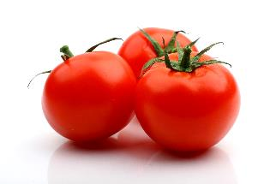
Part 4.0: Communication
Activity 4.1: Practice
Student A
Student B
Ask your roommate if you have the items you need in the kitchen. S/He will tell you what you have and if you can use it.
Then make a list for the store.
Tell your roommate what is in the kitchen and whose it is. If it belongs to Alex or Pedro, you cannot use it.
Alex has: salad dressing
Pedro has: bread, cola
You have: eggs, tomatoes
bread
cola
lettuce
tomatoes
cheese
onions
salad dressing
carrots
milk
eggs
You need to buy:
__________ __________
__________ __________
__________ __________
__________ __________
Notes:
4.1 Salad and a Sandwich
Allow four minutes for this slide.
INSTRUCTIONS
Tell the Students they are going to do a role-play. Say, “You and your roommate need to buy some food at a grocery store to make lunch for friends. You live in a house with two other roommates who do not share their food. You have some food and your roommate has some food. Ask your roommate questions to find out what you need to buy at the grocery store.” For example,
Student A; Do we have bread?
Student B: We have bread, but it’s Pedro’s.
Student A: OK. (adds bread to shopping list)
Student A: Do we have tomatoes?
Student B: Yes. The tomatoes are mine. We can use them.
#1. Reveal the first list and assign two Students the A and B roles. [bread, cola, lettuce, tomatoes, cheese]
#2. Reveal the second list and assign two new Students the A and B roles. [onions, salad dressing, carrots, milk, eggs]

Slide 36

Part 4.0: Communication
Activity 4.1: Practice
Student C
Student D
Ask your roommate if you have the items you need in the kitchen. S/He will tell you what you have and if you can use it.
Then make a list for the store.
Tell your roommate what is in the kitchen and whose it is. If it belongs to Isha or Carol, you cannot use it.
Isha has: eggs
Carol has: tomatoes, tea
You have: salad dressing
bread
tea
carrots
tomatoes
cheese
peppers
salad dressing
carrots
milk
eggs
You need to buy:
__________ __________
__________ __________
__________ __________
__________ __________
Notes:
4.1 Salad and a Sandwich
Allow four minutes for this slide.
INSTRUCTIONS
Tell the Students they are going to do a role-play. Say, “You and your roommate need to buy some food at a grocery store to make lunch for friends. You live in a house with two other roommates who do not share their food. You have some food and your roommate has some food. Ask your roommate questions to find out what you need to buy at the grocery store.”
Have the idle students remember what Student C needs to buy.
#1. This will change the foods that Student C needs to ask about.
Have the Students switch roles and do the activity again.

Slide 37
Part 4.0: Communication
Activity 4.1: Feedback
 |  | Great job! | Well done | Good try | Need more practice
Student 1 | Range: How well you produce a range of language
 | Accuracy: How often you make mistakes
 | Quality of interaction: How well you ask and answer questions
 | Fluency and Spoken Production: How clearly you present ideas
Student 2 | Range: How well you produce a range of language
 | Accuracy: How often you make mistakes
 | Quality of interaction: How well you ask and answer questions
 | Fluency and Spoken Production: How clearly you present ideas
Student 3 | Range: How well you produce a range of language
 | Accuracy: How often you make mistakes
 | Quality of interaction: How well you ask and answer questions
 | Fluency and Spoken Production: How clearly you present ideas
Student 4 | Range: How well you produce a range of language
 | Accuracy: How often you make mistakes
 | Quality of interaction: How well you ask and answer questions
 | Fluency and Spoken Production: How clearly you present ideas
Notes:
4.1 Salad and a Sandwich
FEEDBACK
Quickly give the Students feedback on the target language they just practiced.
If you have a full class, focus on just a couple points each (i.e. their greatest strength and what they need to work on).
Remind them of other resources they can take advantage of to improve their English:
Go to Wall Street World to practice grammar and vocabulary.
Review the Student Manual or Digital Book to study grammar and vocabulary.
Attend Complementary Classes to practice using grammar and vocabulary.
Join Social Clubs to practice speaking skills.

Slide 38
Part 4.0: Communication
Activity 4.2: Context Creation
.
I go to the grocery store and the market
Where do you go to buy food?
Notes:
4.2 Buying Food for Lunch (10 min)
Allow one minute for this slide.
OBJECTIVES
Can name very common types of containers (can; jar; pack; packet; pot; tin)
Can use simple phrases to ask for and provide things, and to discuss what to do next (Can you give me that? Can you give me your ID?)
INSTRUCTIONS
Ask the Students what they needed to get in the previous activity and if they want to pick up anything else for lunch.
#1. Have a Student read the question. [Where do you go to buy food?]
#2. Encourage the Students to answer, based on their own experiences.
#3. Reveal the sample answer. [I go to the grocery store and the market.]
TEACHING TIPS
Brainstorm/elicit a variety of the target language, which will be used and assessed during the practice.
Elicit from each Student.
It helps to board elicited language.

Slide 39
Part 4.0: Communication
Activity 4.2: Context Creation
?
Do you have any…
?
How much does it cost
What can you ask someone at a market when you are buying food?
?
Can I have some…
Notes:
4.2 Buying Food for Lunch
Allow one minute for this slide.
INSTRUCTIONS
#1. Have a Student read the question. [What can you ask someone at a market when you are buying food?]
#2. Encourage the Students to answer.
#3. Reveal the sample answers. [Do you have any…?/How much does it cost?/Can I have some…?]
TEACHING TIPS
Brainstorm/elicit a variety of the target language, which will be used and assessed during the practice.
Elicit from each Student.
It helps to board elicited language.

Slide 40

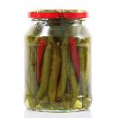
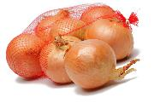




Part 4.0: Communication
Activity 4.2: Practice
Student A
Student B
You need to buy things to make lunch. You only have $20. You go to the market to buy these things. Talk to the salesman at the market, and see what you can buy.
You work at a market.
You can sell these things:
Item | Cost
Lettuce | 1 box = $3
Peppers | 1 jar = $4
Apples | 1 bag = $5
Chips | 1 bag = $1
Tomatoes | 1 can = $2
Rice | 1 bag = $2
Onions | 1 bag = $2
Notes:
4.2 Buying Food for Lunch
Allow four minutes for this slide.
INSTRUCTIONS
Tell the Students, “Student A has $20 and is going to the market to buy food for lunch. Student B works at the market. Student A asks Student B about food and prices to decide what she or he can buy. Student B answers Student A’s questions. Read the information on the screen before you begin.”
Give the Students one minute to look over the information on the screen. Then instruct Students to begin the activity.
Allow two minutes for the first role-play. Get feedback in open class to find out what the Student bought.
Have the Students swap roles, and repeat the role-play.
For example,
Student A: Do you have any cans of tomatoes?
Student B: Yes, we do.
Student A: How much do they cost?
Student B: One can is $2.
Student A: Can I have two cans of tomatoes please?
Student B: Yes, here you are.

Slide 41

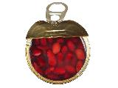
Part 4.0: Communication
Activity 4.2: Practice
Student C
Student D
You need to buy things to make lunch. You only have $20. You go to the market to buy these things. Talk to the salesman at the market, and see what you can buy.
You work at a market.
You can sell these things:
Item | Cost
Lettuce | 1 box = $3
Peppers | 1 jar = $4
Apples | 1 bag = $5
Chips | 1 bag = $1
Tomatoes | 1 can = $2
Beans | 1 can = $2
Sugar | 1 packet = $1
Notes:
4.2 Buying Food for Lunch
Allow four minutes for this slide.
INSTRUCTIONS
The Students role-play the market encounter.
Give the Students one minute to look over the information on the screen. Then instruct Students to begin the activity.
Allow two minutes for the first role-play. Get feedback in open class to find out what the Student bought.
Have the Students swap roles, and repeat the role-play.

Slide 42
Part 4.0: Communication
Activity 4.2: Extension
Let’s plan a dinner to welcome our new Wall Street English Teacher!
Notes:
4.2 Buying Food for Lunch
Optional Extension
INSTRUCTIONS
#1. Have a Student read the text. [Let’s plan a dinner to welcome our new Wall Street English Teacher!]
Tell the Students that they will now plan a dinner to welcome a new Wall Street English Teacher. Working with their classmates, they should first make a shopping list. Then, they should make a plan for going to the store to buy the things on their list.

Slide 43
Part 4.0: Communication
Activity 4.2: Practice
 |  | Great job! | Well done | Good try | Need more practice
Student 1 | Range: How well you produce a range of language
 | Accuracy: How often you make mistakes
 | Quality of interaction: How well you ask and answer questions
 | Fluency and Spoken Production: How clearly you present ideas
Student 2 | Range: How well you produce a range of language
 | Accuracy: How often you make mistakes
 | Quality of interaction: How well you ask and answer questions
 | Fluency and Spoken Production: How clearly you present ideas
Student 3 | Range: How well you produce a range of language
 | Accuracy: How often you make mistakes
 | Quality of interaction: How well you ask and answer questions
 | Fluency and Spoken Production: How clearly you present ideas
Student 4 | Range: How well you produce a range of language
 | Accuracy: How often you make mistakes
 | Quality of interaction: How well you ask and answer questions
 | Fluency and Spoken Production: How clearly you present ideas
Notes:
4.2 Buying Food for Lunch
FEEDBACK
Quickly give the Students feedback on the target language they just practiced.
If you have a full class, focus on just a couple points each (i.e. their greatest strength and what they need to work on).
Remind them of other resources they can take advantage of to improve their English:
Go to Wall Street World to practice grammar and vocabulary.
Review the Student Manual or Digital Book to study grammar and vocabulary.
Attend Complementary Classes to practice using grammar and vocabulary.
Join Social Clubs to practice speaking skills.

Slide 44
Encounter 21
Overall Feedback
 |  | Great job! | Well done | Good try | Need more practice
 | Activity 2.1: Containers
 | Activity 2.2: Can I Have a Bag of Rice?
 | Activity 3.1: I Love Fruit, but I Hate Vegetables!
 | Activity 3.2: Talk about Possessions
 | Activity 4.1: Salad and a Sandwich
 | Activity 4.2: Buying Food for Lunch
Student 1
Feedback
Notes:
OVERALL FEEDBACK (3–5 min)
Allow one minute for this slide.
Explain to the Students that you will now be giving them an overall assessment and recommendations. Use the following prompts to help you explain the assessment:
First, you did a really good job of…
The areas where you could use a little more practice are…
The language points I didn’t hear you use were...
As a result, I’d recommend that you… [continue on to Unit 22… work on (X, Y, Z ) and repeat Encounter 21].
Do you have any questions?

Slide 45
Encounter 21
Overall Feedback
 |  | Great job! | Well done | Good try | Need more practice
 | Activity 2.1: Containers
 | Activity 2.2: Can I Have a Bag of Rice?
 | Activity 3.1: I Love Fruit, but I Hate Vegetables!
 | Activity 3.2: Talk about Possessions
 | Activity 4.1: Salad and a Sandwich
 | Activity 4.2: Buying Food for Lunch
Student 2
Feedback
Notes:
OVERALL FEEDBACK (3–5 min)
Allow one minute for this slide.
Explain to the Students that you will now be giving them an overall assessment and recommendations. Use the following prompts to help you explain the assessment:
First, you did a really good job of…
The areas where you could use a little more practice are…
The language points I didn’t hear you use were...
As a result, I’d recommend that you… [continue on to Unit 22… work on (X, Y, Z ) and repeat Encounter 21].
Do you have any questions?

Slide 46
Encounter 21
Overall Feedback
 |  | Great job! | Well done | Good try | Need more practice
 | Activity 2.1: Containers
 | Activity 2.2: Can I Have a Bag of Rice?
 | Activity 3.1: I Love Fruit, but I Hate Vegetables!
 | Activity 3.2: Talk about Possessions
 | Activity 4.1: Salad and a Sandwich
 | Activity 4.2: Buying Food for Lunch
Student 3
Feedback
Notes:
OVERALL FEEDBACK (3–5 min)
Allow one minute for this slide.
Explain to the Students that you will now be giving them an overall assessment and recommendations. Use the following prompts to help you explain the assessment:
First, you did a really good job of…
The areas where you could use a little more practice are…
The language points I didn’t hear you use were...
As a result, I’d recommend that you… [continue on to Unit 22… work on (X, Y, Z ) and repeat Encounter 21].
Do you have any questions?

Slide 47
Encounter 21
Overall Feedback
 |  | Great job! | Well done | Good try | Need more practice
 | Activity 2.1: Containers
 | Activity 2.2: Can I Have a Bag of Rice?
 | Activity 3.1: I Love Fruit, but I Hate Vegetables!
 | Activity 3.2: Talk about Possessions
 | Activity 4.1: Salad and a Sandwich
 | Activity 4.2: Buying Food for Lunch
Student 4
Feedback
Notes:
OVERALL FEEDBACK (3–5 min)
Allow one minute for this slide.
Explain to the Students that you will now be giving them an overall assessment and recommendations. Use the following prompts to help you explain the assessment:
First, you did a really good job of…
The areas where you could use a little more practice are…
The language points I didn’t hear you use were...
As a result, I’d recommend that you… [continue on to Unit 22… work on (X, Y, Z ) and repeat Encounter 21].
Do you have any questions?

Slide 48







Part 5.0: Wrap-Up
Notes:
5.1 Win a Point (10 min)
Allow ten minutes for this slide.
OBJECTIVE
• To review and practice target language from the Unit
INSTRUCTIONS
Direct the Students’ attention to the image of the bag of chips and ask the class, “What is this?”
Elicit “bag of chips,” and award one point to the Student who says it first.
Next, ask, “Who can say a sentence with ‘bag of chips’?” Give the Students thirty seconds to discuss and then give their answers. For example,
Can I have a bag of chips, please?
It’s his bag of chips.
That is Daniel’s bag of chips.
For each correct sentence, award one point to the Student.
Repeat with the remaining images. Keep score and use a stopwatch to keep the activity fast paced.
#2. Reveal the can of beans.
#3. Reveal the packet of sugar.
#4. Reveal the box of lettuce.
#5. Reveal the bag of onions.
#6. Reveal the can of tomatoes.
#7. Reveal the bag of rice.
#8. Reveal the jar of peppers.
TEACHING TIP
Make sure each Student has a chance to give an example sentence.

Slide 49

Thank you for coming.
We hope you enjoyed the class.
Don’t forget
to leave feedback!
Teacher
Class was fun
Instructions were clear
«««««
«««««
«««««

Slide 50
© 2017 by Pearson Education Limited All rights reserved.
No part of this publication may be reproduced, stored in a retrieval system, or transmitted in any form or by any means, electronic, mechanical, photocopying, recording or otherwise without the permission of the Publishers.
This material is the intellectual property of Pearson Education Limited.
Image Credits:
Giuseppe Porzani/Fotolia; angorius/Fotolia; dkidpix/Fotolia; tpzijl/Fotolia; Radu Razvan/Fotolia; MovingMoment/Fotolia; Andrzej Tokarski/Fotolia; photomelon/Fotolia; alexandro900/Fotolia; Radu Razvan/Fotolia; 123rf.com; Yellowj/Shutterstock; 123rf.com; Patryk Kosmider/Fotolia; LeventeGyori/Shutterstock; Pixavril/Fotolia; siamionau pavel/Shutterstock; dusk/Fotolia; Sergio Martnez/Fotolia; MovingMoment/Fotolia; lculig/Fotolia; vgstudio/Fotolia; i_tkach/Fotolia; mimagephotos/Fotolia; Stuart Monk/Fotolia; auremar/Fotolia; Shmel/Fotolia; sirikorn_t/Fotolia; tpzijl/Fotolia; Giuseppe Porzani/Fotolia; angorius/Fotolia; dkidpix/Fotolia; Radu Razvan/Fotolia; MovingMoment/Fotolia; Szasz-Fabian Erika/Fotolia; EpicStockMedia/Fotolia

